Slide 1
TFE: Energy-efficient Transferred Filter-based Engine to Compress and Accelerate Convolutional Neural Networks

Slide 2
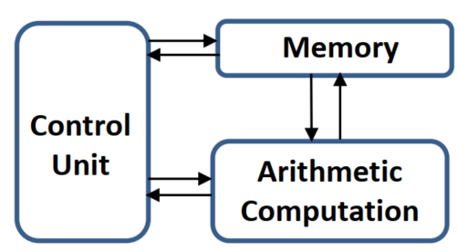
Introduction
CNNs have greatly enhanced the development of many fields.
These works largely rely on millions of parameters and computations to achieve high accuracy.
The untenable number of parameters and computations in CNNs yield significant performance and energy challenges in hardware implementations.
Large memory requirement & intensive computations
A large number of parameters have to be stored in off-chip DRAM, which causes frequent access to the off-chip DRAM

Slide 3
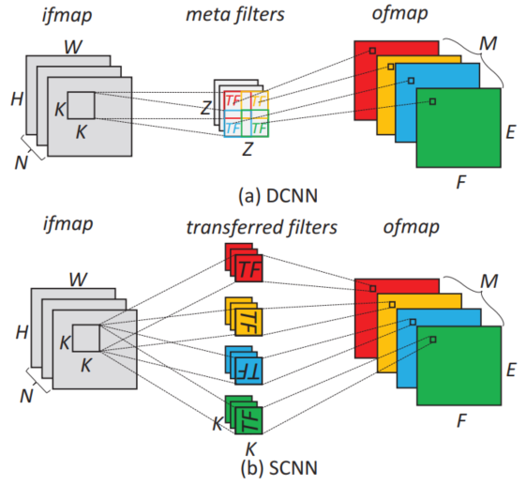
Related Works
The size of meta filters larger than the transferred filters
Transferred filter-based algorithms
DCNN rests on the finding that many filters in well-trained CNNs are slightly translated versions of each other.
SCNN learns that filters in CNN models always detect particular patterns at multiple spatial locations in the input and these patterns often occur in different orientations.

Slide 4
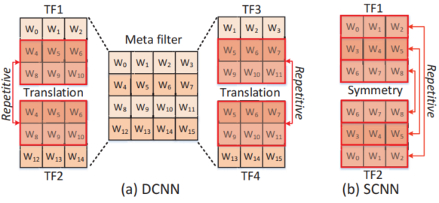
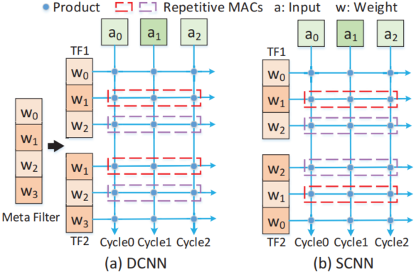
Repetitive Computation
Repetitive transferred rows

Slide 5
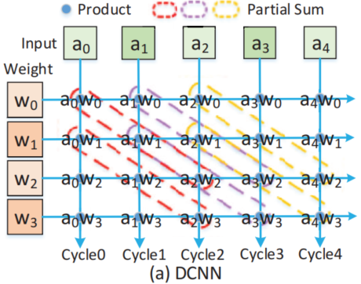
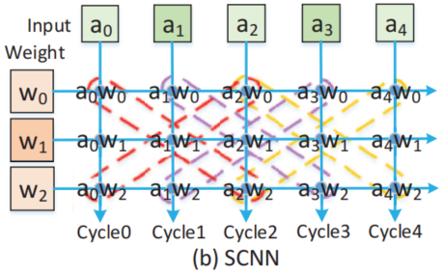
Repetitive Computation Optimization
Shared Partial Sums and Products
the product a1w1 should not be overwritten immediately.
These products will be recomputed in the conventional WS dataflow.
The symmetric property of the SCNN in the horizontal direction

Slide 6
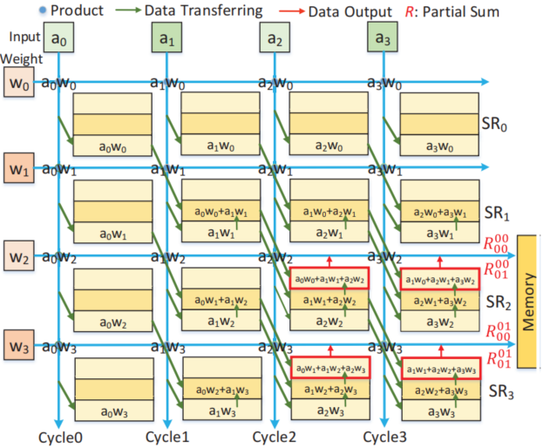
Repetitive Computation Optimization
Product and Partial Sum Reuse (PPSR)
消耗了4个 register来存 储，即SR0-SR3 W0-W2属于第0个 TF，W1-W3属于 第1个TF对应于 j=0,1
每个register (SR)的大 小/行数，和 对应的TF大小 有关，如果TF 需要k次相加 得到psum，那 么就需要k行

Slide 7
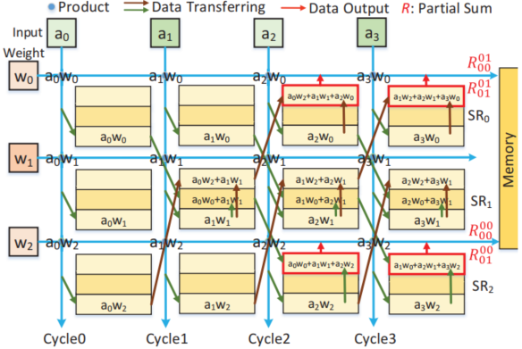
Repetitive Computation Optimization
Product and Partial Sum Reuse (PPSR)

Slide 8
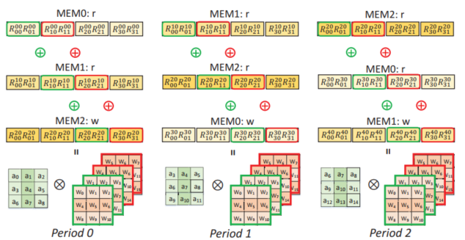
Repetitive Computation Optimization
Entire Row Result Reuse(ERRR)
DCNN: both the memory and PSums of the entire row are cyclically reused, saving hardware resources and eliminating repetitive MACs among different filter rows
Notes:
第 3行row计算 结果需要和前 2行算出的psum 累加得出一个卷积窗口的result

Slide 9
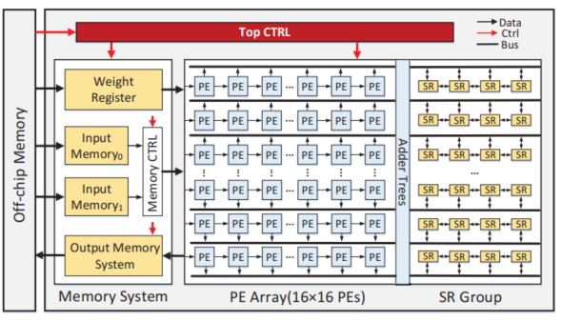
Hardware Architecture
该架构的面积为Eyeriss结构的57.96%，功耗为其24.12%。
传统的架构中， 只有两个global memory，用于 CONV和FC存储 中间数据，即 输入PE阵列的 input data和 PE阵列输出的 output data

Slide 10
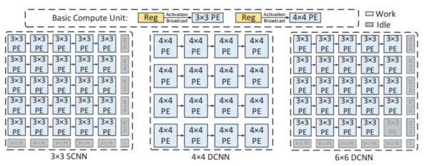
Hardware Architecture
For 11×11 filters in the first layer of AlexNet, they can be first partitioned into nine 4×4 small filters, which can be supported by nine 4×4 PE sub-arrays.

Slide 11
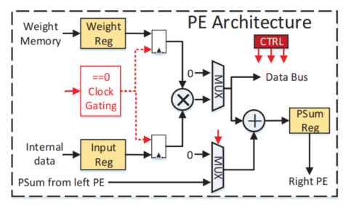
Hardware Architecture
The clock gating technique is used to avoid multipliers’ unnecessary toggling when the weight or input is zero, which can further save approximately 5% of dynamic power.

Slide 12
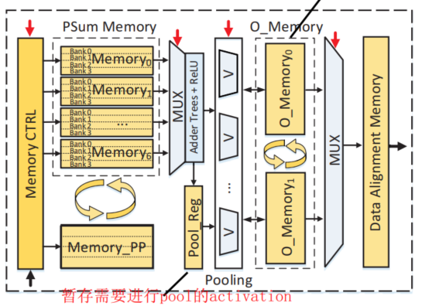
Hardware Architecture
The two pieces of input memory work in ping-pong mode.
O_Memory to support the pooling operation

Slide 13
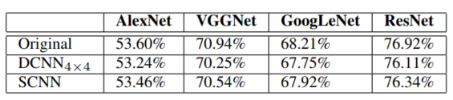
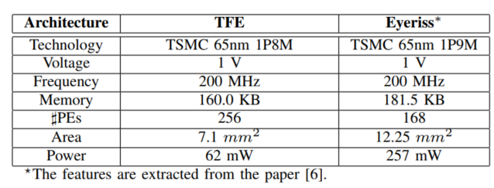
Experimental Results

Slide 14
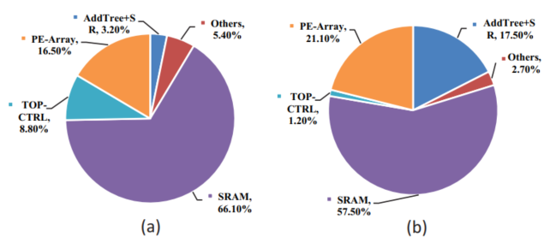
Experimental Results
Area breakdown and power breakdown of the TFE

Slide 15
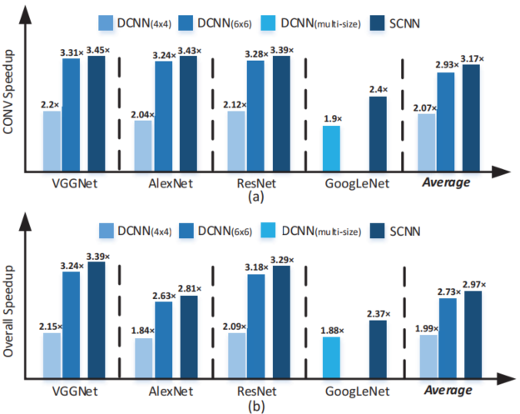
Experimental Results
CONV layers and overall Speedup with the DCNN and SCNN based on the TFE

Slide 16
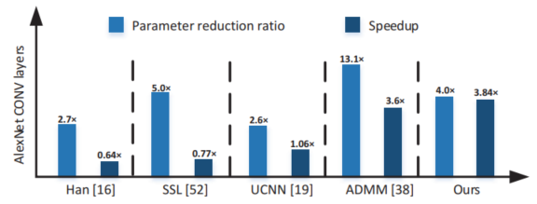
Experimental Results
Parameter reduction ratio and speedup comparison results with compression-based methods on the CONV layers of AlexNet.

Slide 17
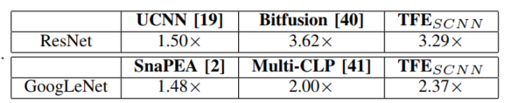
Experimental Results
Parameter reduction ratio and speedup comparison results with compression-based methods on the CONV layers of AlexNet.
Overall speedup of other methods over Eyeriss.

Slide 18
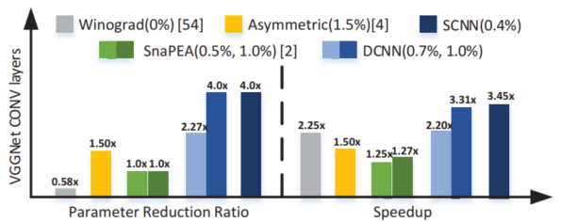
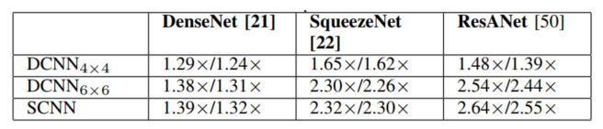
Experimental Results
Parameter reduction ratio and speedup comparison results with computation-reduction-based works on CONV layers of VGGNet
Speedups of CONV layers and overall network with recent networks

Slide 19
谢 谢！

